Slide 1
Guideline GEOMEC
Famke Kraaijeveld, PTI/RC+ Peter Fokker, PTI/RC

Slide 2
Geomec as engine
Although the CORA workflow is the same as for the other engines with some differences accounting for the complexity of Geomec:
  Name convention of objects: avoid characters like .,()
  Supported material models
  Handling distributed parameters: linear correlations
  Objects of interest in the model
  Calculating failure: weighted over the elements
  Re-run option: analyse cases of interest or calculations with errors

Slide 3
Supported material models
Linear model
Nonlinear models
Elasticity parameters | Young’s & Poisson’s (Manual) | Bulk & Shear modulus (Bulk stiffness) | Compressibility and Poisson’s ratio (Manual) | Compressibility and Shear modulus (Bulk stiffness)
 | Young’s Modulus | Bulk Stiffness | Poisson’s ratio | Shear modulus
 | Poisson’s Ratio | Shear Modulus | Uniaxial Elastic Compressibility | Uniaxial Elastic Compressibility
 | Young’s modulus in decompaction
 | Poisson’s ratio in decompaction
In situ stress parameters | Density
 | LatRatioMin (Shtot/Svtot)
 | LatRatioMax (SHtot/Svtot)
 | LatRatioMaxAzimuth (SHtot azimuth)
Post-processing parameters | Cohesion
 | Friction Angle
 | Pc,0
Type | Included nonlinear material parameters
Cam-Clay | Hardening | Compressibility
 | Hardening Parameter | Uniaxial Plastic Compressibility
 | Preconsolidation Stress | Preconsolidation Stress
Mohr Coulomb
Note: please use parameters from a single
column. Using more than two elasticity
parameters per formation, because Geomec
will be confused.

Slide 4
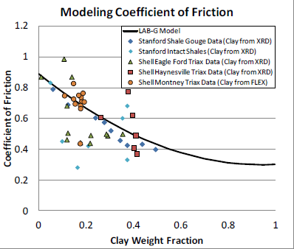
Handling distributed properties
  Parameter & uncertainty distribution
  Keeps spatial correlation by shift, factor as stochasts:
  e.g. factor * <parameter> + shift
  Example: factor*Cohesion,
  factor uniform distributed
  between 0.5 and 1.5

Slide 5
Available objects and failure mechanisms
Object | Type of failure | Geomec export type | Analysis | LSF type
Fault | Shear failure | FaultShearCap | L, N | Max, Area
 | Total slip | FaultDisplacementL | N | Max, Area
 | Plastic slip | FaultDisplacementL | L, N | Max, Area
Formation | Shear failure/ Shear capacity | ShearCap | L, N | Max, Vol
 | Compressive failure | EPStress1L | L,N | Max, Vol
 | Tensile failure | EPStress3L | L, N | Min, Vol
 | Compaction failure | PStrain1L | L, N | Max, Vol
 | Extension failure | PStrain3L | L, N | Min, Vol
 | Volumetric Compaction / extension failure | StrainInvVolumetric | L, N | Max, Vol Max, min, Vol min
 | Compressive Plastic Strain | PStrain1PlasticL | N | Max, Vol
 | Extensional Plastic Strain | PStrain3PlasticL | N | Min, Vol
 | PCU / Compaction Capacity | CompactionCap | L,N | Max, Vol
Well | Shear failure | ShearCap | L,N | Max, Length
 | Axial compression & extension | WPAxialStrain | L, N | Max, Length Max, Min, Length Min
Top surface / seabed | Subsidence & upheave | DisplacementV | L, N | Max, Area Max,, Min, Area Min
 | Penalty | Not available yet | L, N | Max, Area
All | User defined |  |  | Max , Min

Slide 6
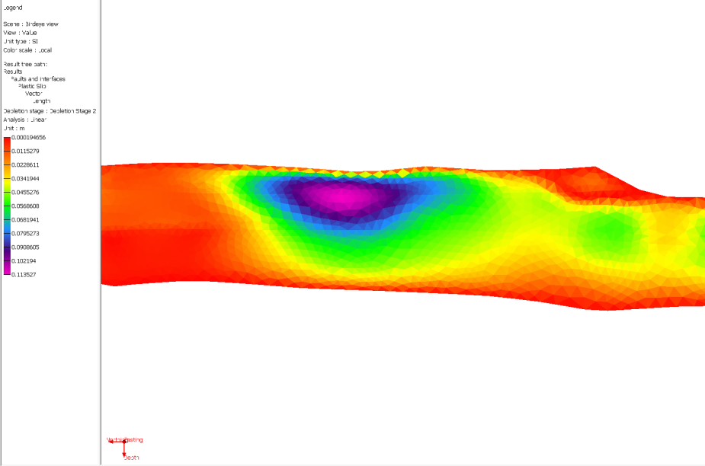
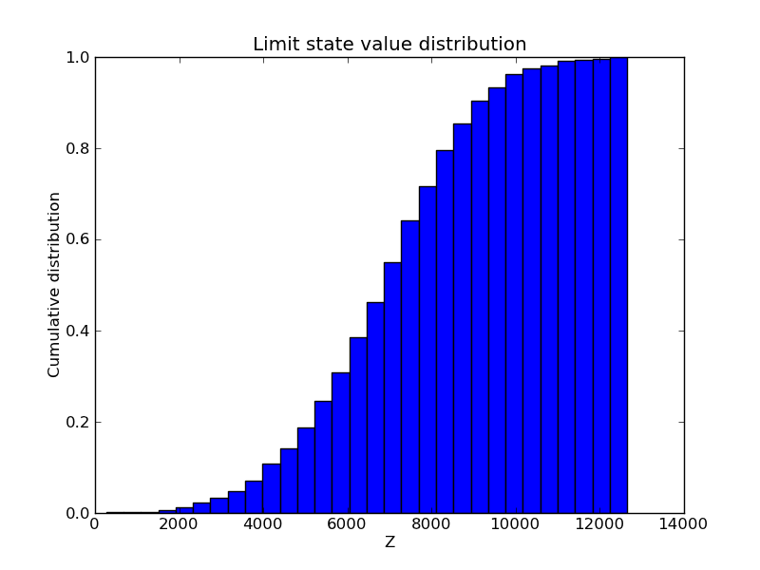
Calculating failure
Fault analysis by for instance
  A: Elements SCU > 1
  B: Elements slip_plastic > 20 cm
  % surface failed > 10%
  Requires:
  Critical value in Geomec as material/object parameter, provided as limiter
  Weighted average over surface or nonweigted over points
  Distribution of response Z (failed area, or failed # elements, %), available later.

Slide 7
Geomec workflow

Slide 8
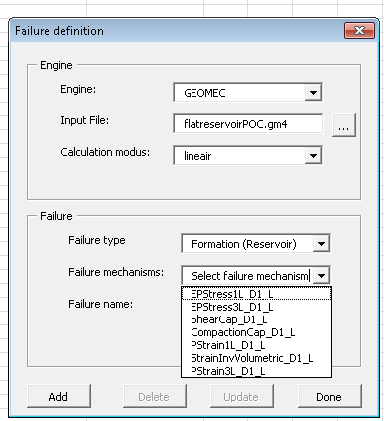
Define failure model
The model including objects of failure and failure mechanism are defined here.
Step 1: Choose your engine: Geomec
Step 2: Browse to the Geomec file, which has to be built on forehand
Step 3: Select the analysis mode (Linear / Nonlinear)
Step 4: Select the object of failure and appropriate failure mechanisms
Step 5: Press <Add>
Repeat until <Done>

Slide 9
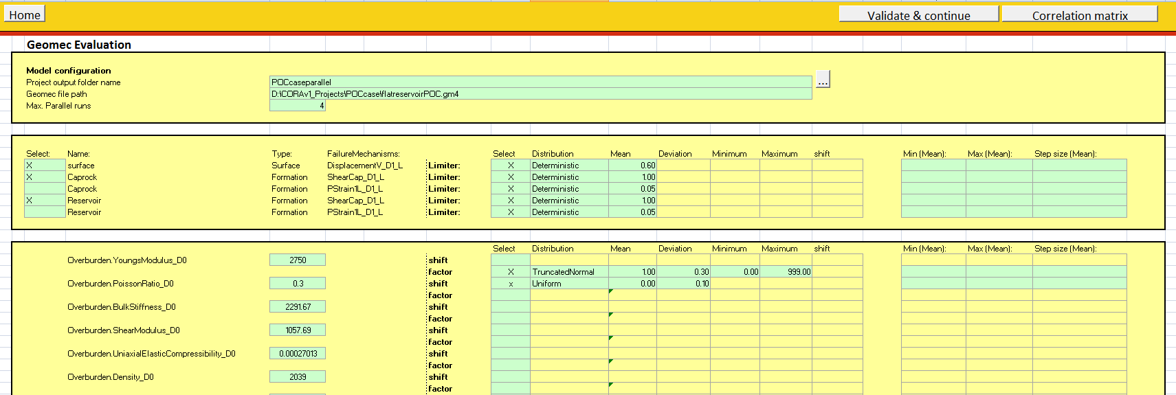
Define uncertainties
Only uncertainties need to be inputted.
Step 1: Go to sheet <Geomec>
Step 2: Fill in calculation path and number of parallel threads
Step 3: Select the failure mechanisms and define the failure limits
Step 4: Define the uncertainty distributions and correlations (Button right top corner)
Step 6: Define min, max and step size for the control parameters (reliability analysis) when wanted
Step 7: When satisfied press <Validate and continue>
LSFs
PDFs

Slide 10
Further analysis
The rest of the workflow is the same as for the other engines.
Quick screening:
  In the quick screening, all LSFs associated with the failure mechanisms will be calculated, namely: min/max, weighted mean, failure area/volume and failure area/volume percentage
  The relation between the parameters and the responses can be analysed by examining the different proxies.
  Reliability analysis
  The limit function of choice can be selected or all
  The limit of failure should be given (e.g. maximum % failure area)

Slide 11
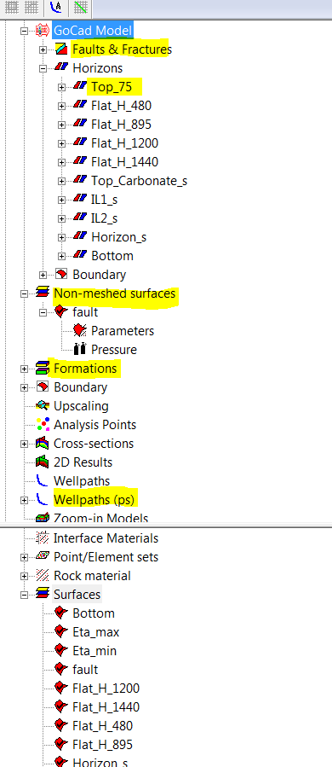
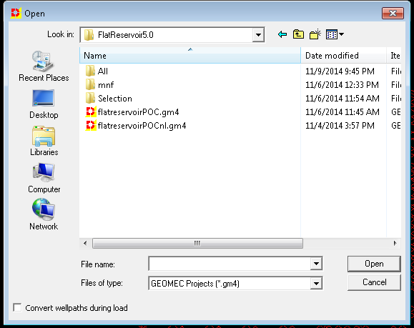
Geomec best practice
  Check your model before starting probabilistic analysis
  Reduce the number of parameters and objects of interest as much as you can.
  Only non-meshed faults which are dragged to the model tree can be analyzed
  Only wells in new format can be used for analysis. To convert them to the new format, you can open your model in Geomec and select <Convert wellpaths during load> when selecting your file.

Slide 12
ExamplE use of Geomec

Slide 13
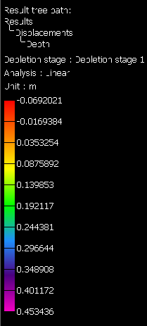


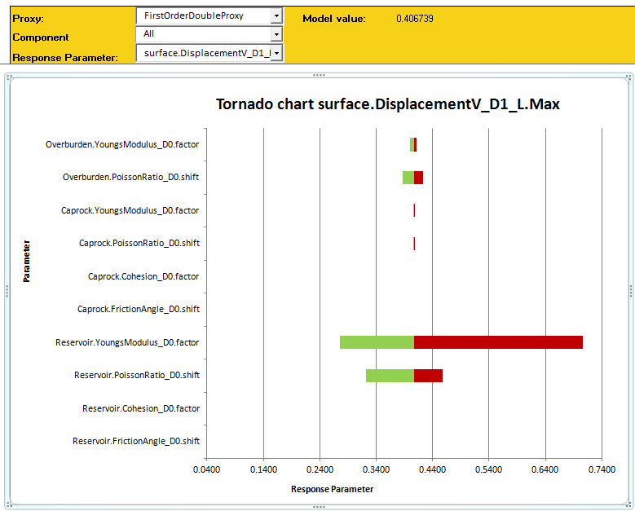
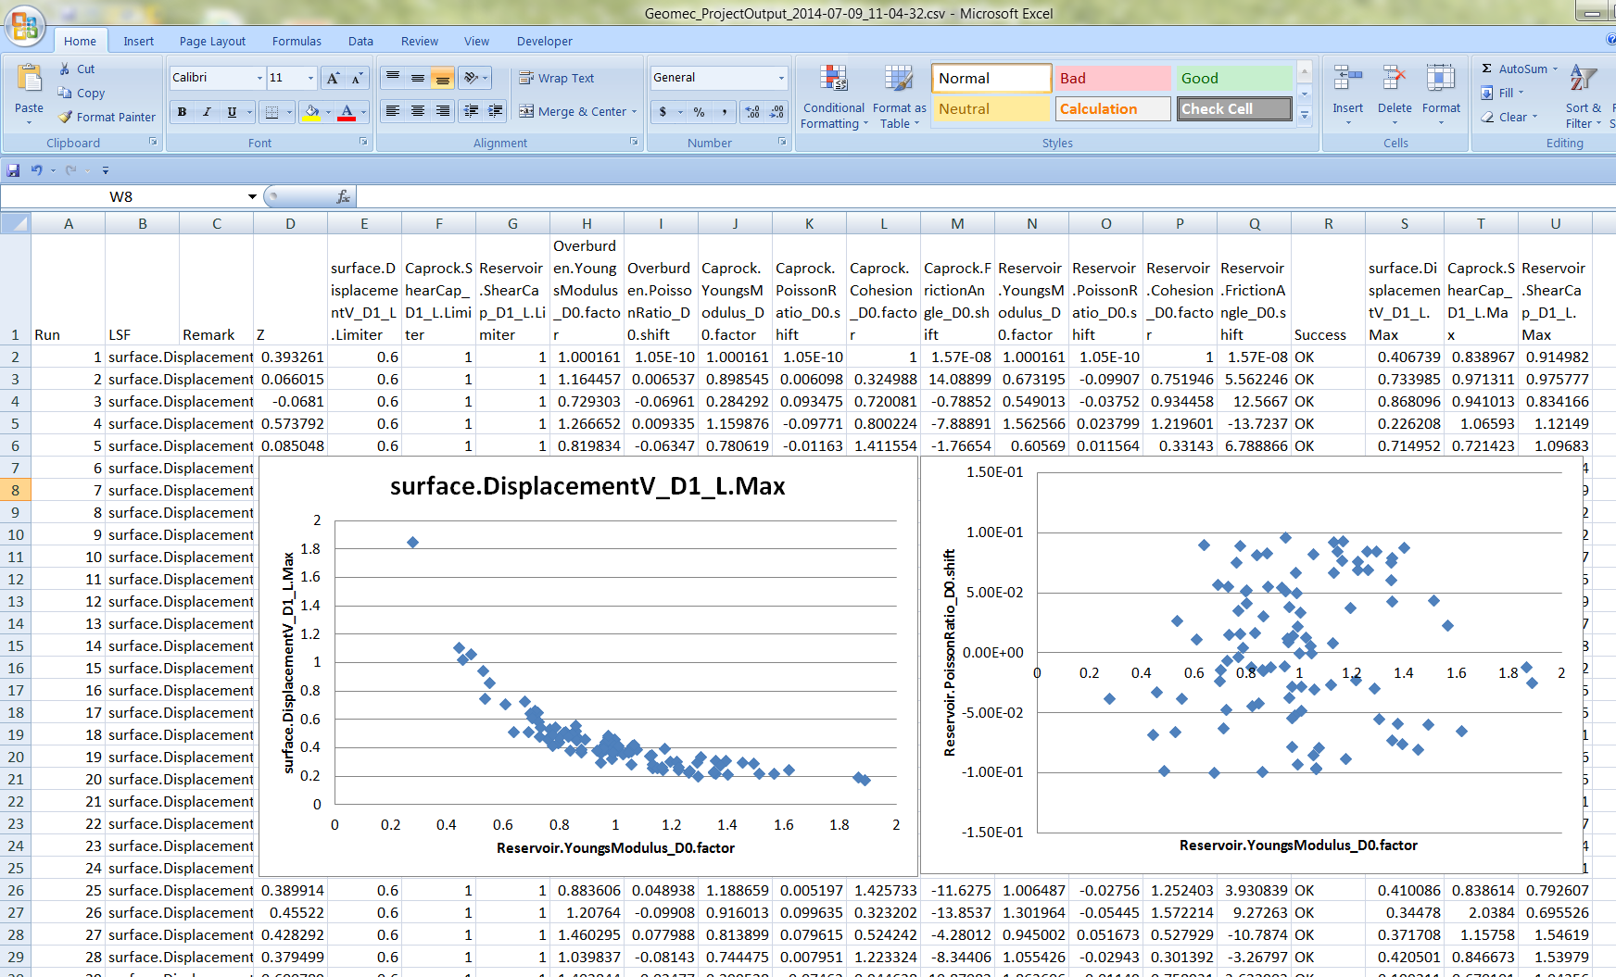
Example: Subsidence for Flat reservoir
Step 1: Base case model (results: subsidence)
Step 2: Prescribing reliability analysis case & quick screening
Step 3: Do failure analysis

